Slide 1

WatchLog
School of Computer Science and Engineering
Department of Computer Science and Engineering
Submitted By:
Harsh Kumar
2427030229
Supervised By:
Dr. Neha Janu

Slide 2
Outline
Introduction
Literature Review
Problem Statement
Proposed Solution
Objectives
Results

Slide 3
Introduction
• System logs are essential for monitoring system health, security, and performance in modern distributed environments.
• Centralized anomaly detection methods compromise privacy and face scalability challenges.
• Deep learning techniques like LSTM Autoencoders can detect complex sequential anomalies effectively.
• WatchLog integrates Federated Learning with LSTM Autoencoders to provide a privacy-preserving, scalable, and automated anomaly detection solution.

Slide 4
Literature Review — Existing Approaches
• Log anomaly detection is critical for ensuring reliability, security, and performance in modern distributed systems such as cloud infrastructure and enterprise servers.
• Traditional centralized machine learning approaches require collecting all log data on a central server, creating privacy risks, scalability issues, and single points of failure.
• Deep learning models such as DeepLog (2017) and LogAnomaly (2019) use LSTM networks to capture sequential patterns in logs and detect anomalies effectively.
• Transformer-based models like LogBERT (2021) further improve anomaly detection accuracy by learning complex contextual relationships in log sequences.

Slide 5
Literature Review — Federated Learning & Research Gap
• Federated Learning enables decentralized model training across multiple clients without sharing raw log data, preserving privacy and improving scalability.
• Recent systems such as FedLog (2024) and federated anomaly detection models combine distributed learning with deep neural networks for improved detection.
• LSTM Autoencoders have proven effective for unsupervised anomaly detection by learning normal behavior and detecting deviations using reconstruction error.
• However, existing systems lack a complete integration of Federated Learning with LSTM Autoencoders for privacy-preserving, scalable, and real-world log anomaly detection.

Slide 6
Problem Statement
Modern IT systems generate massive volumes of log data, making manual monitoring inefficient, while centralized machine learning approaches compromise privacy and fail to effectively detect complex sequential anomalies.

Slide 7
Objectives
• Develop a privacy-preserving log anomaly detection system using Federated Learning without sharing raw log data.
• Implement an LSTM Autoencoder to learn sequential log patterns and accurately detect anomalies using reconstruction error.
• Design a scalable and decentralized architecture that enables collaborative model training across multiple distributed clients.
• Improve anomaly detection performance in terms of accuracy, precision, recall, and overall system reliability.

Slide 8
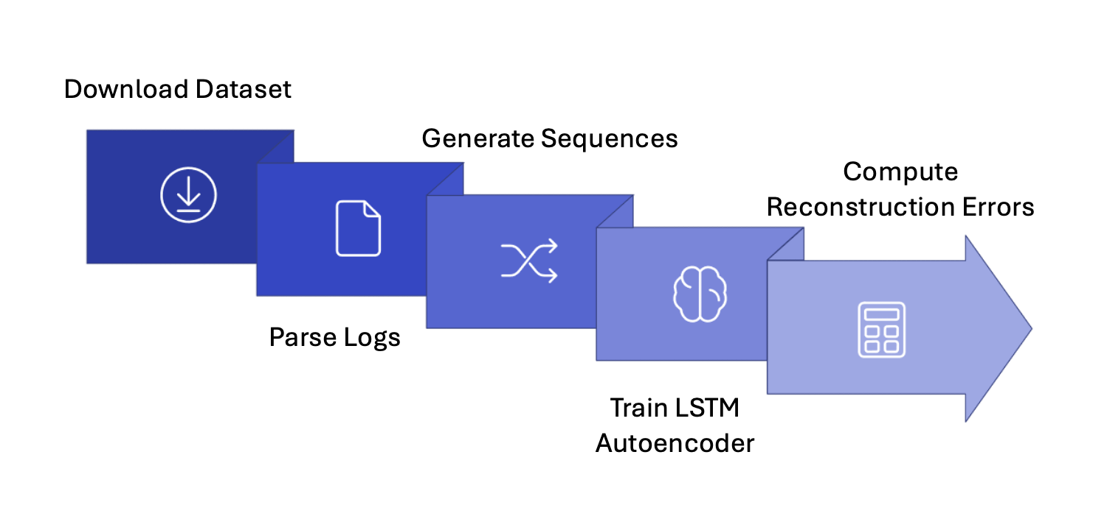
Proposed Methodology

Slide 9
Dataset and Log Preprocessing
• HDFS (Hadoop Distributed File System) log dataset is used as the input data source.
• Raw log messages are parsed using the Drain log parsing algorithm to convert unstructured logs into structured templates.
• Each log template is assigned a unique Event ID to convert textual data into numerical format.
• A sliding window technique is used to generate sequential log event sequences for model training.

Slide 10
LSTM Autoencoder Model Architecture
• An LSTM Autoencoder is used to learn normal log sequence patterns.
• The Encoder compresses input log sequences into a lower-dimensional latent representation.
• The Decoder reconstructs the original log sequence from the latent space.
• Reconstruction error is calculated as the difference between input and reconstructed sequence to detect anomalies.

Slide 11
Federated Learning Framework
• Multiple clients train the LSTM Autoencoder locally using their private log data.
• Raw log data never leaves the client, ensuring complete data privacy and security.
• A central server aggregates model weights using the FedAvg (Federated Averaging) algorithm.
• The updated global model is shared with all clients to improve detection performance collaboratively.

Slide 12
Anomaly Detection Workflow
• Log data is parsed and converted into event sequences.
• LSTM Autoencoder is trained to learn normal system behavior.
• Reconstruction error is computed for each log sequence.
• Threshold-based methods (Percentile, Standard Deviation, IQR) are used to classify anomalies.

Slide 13
Result
1. Tabular Result
Metric | Existing System | WatchLog (Proposed) | Improvement
Accuracy | 83.1% | 96% | +12.9%
Precision | 74.1% | 92% | +17.9%
Recall | 88.3% | 95% | +6.7%
F1 Score | 81.0% | 93% | +12.0%

Slide 14
2. Bar Chart

Slide 15
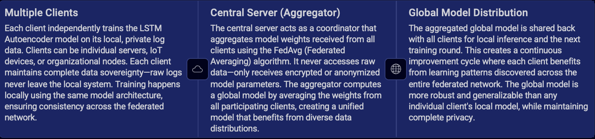
3. Federated Learning Architecture
Advantages:
Guarantees privacy by keeping sensitive log data on local devices—no centralized data repository means reduced breach risk and compliance with GDPR, HIPAA, and other regulations.
Enhances security during model training by decentralizing the process—eliminates single points of failure and reduces attack surface.
Facilitates distributed learning, enabling collaboration without data exposure—organizations can benefit from collective intelligence without sharing proprietary information.
Improves model robustness by training on diverse, heterogeneous data distributions across multiple clients.
Reduces communication overhead compared to centralized approaches by only transmitting model parameters instead of raw data.

Slide 16
Outcome
• Successfully developed WatchLog, a privacy-preserving log anomaly detection system using Federated Learning and LSTM Autoencoder.
• Implemented decentralized model training where raw log data remains on local clients, ensuring complete data privacy and security.
• Achieved high anomaly detection performance (96% accuracy, 93% F1 score) on the HDFS log dataset, outperforming existing methods.
• Designed a scalable and distributed architecture suitable for real-world enterprise and cloud infrastructure monitoring.
• Real-time deployment: Partially completed (model training and federated framework implemented; full deployment planned).
• Research Paper: Draft in progress based on WatchLog system and experimental results.

Slide 17
References
Nogami, K., Tamura, H., Tanaka, G. “Federated Learning with Reservoir State Analysis for Time Series Anomaly Detection.” IEEE, 2025.
Vasiljevic, P., Matic, M., Popovic, M. “Federated Isolation Forest for Efficient Anomaly Detection on Edge IoT Systems.” IEEE, 2025.
Rahman, R., Shaham, S., Nguyen, D. C. “Towards Personalized Quantum Federated Learning for Anomaly Detection.” IEEE, 2025.
Himler, P., Landauer, M., Skopik, F. “FedLog: Federated Learning for Log Anomaly Detection.” IEEE, 2024.
Du, M., et al. “DeepLog: Anomaly Detection and Diagnosis from System Logs using Deep Learning.” IEEE CCS, 2017.
Meng, W., et al. “LogAnomaly: Unsupervised Detection of Sequential and Quantitative Anomalies.” IJCAI, 2019.
Provotar, O., Linder, Y. “LSTM Autoencoders for Unsupervised Anomaly Detection.” IEEE, 2020.

Slide 18
Thank You

